Slide 1


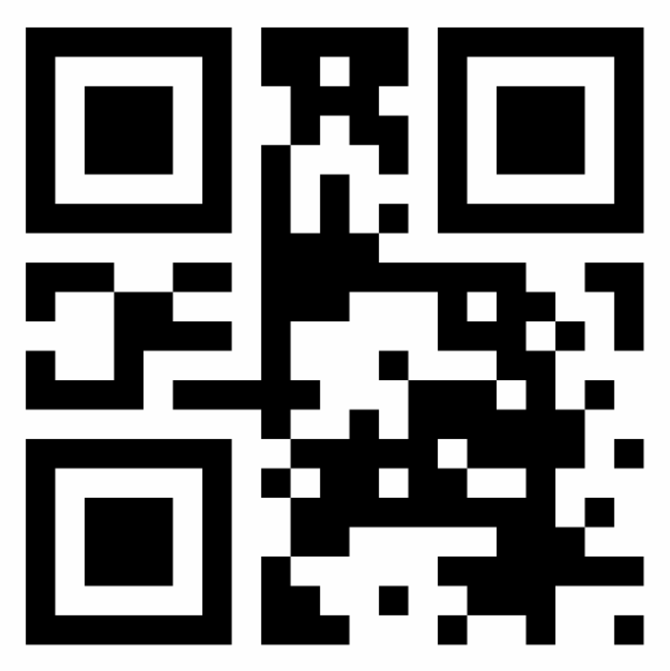






Brokers
Wallets are the users’ entry point to the Trust Framework. They store, on the user’s device, the users’ asymmetric private key – the only mechanism to digitally sign information-sharing orders from the user. Wallets also store the wallet’s QR code and the anonymized 3rd Party (3P) stickers. brokers are wallet backends, responsible for the orchestration between wallets, vaults, and 3Ps. Wallets and brokers don’t receive nor store user’s PII. Both can be offered by any vendor, without preestablished trust relationship with vaults and 3Ps – instead, users choose who they trust.
1
Users register on any wallet compatible with the trust framework. Wallets create key pairs with asymmetric cryptography. The private key signs the wallet’s messages and never leaves the device, while the public key is shared with other actors for them to verify the authenticity of the wallet’s requests.
Users access their wallet’s app. The wallet then sends only the public key to the wallet’s broker, for it to register the user in the broker’s domain.
With the broker’s answer, the wallet generates and stores the wallet’s QR code, with which the wallet’s owner can scan on 3P desks to initiate check-ins.
The wallet has a notifier API to receive commands from the broker. The API abstracts the wallet’s push tech from the broker, and verifies the broker’s signatures with the broker’s public key.
The broker calls the API whenever a 3P requests the user to share their vaults.
The broker also calls the wallet’s API to push new 3P stickers created by 3Ps.
Architecture
3
Asymmetric
cryptography
W
S
Any Wallet
e.g. ACME
private
key
wallet’s QR code
sharing approval
credentials
1
4
4
6
7
3
register
push
push
5
6
Wallet’s Notifier API
7
3
Asymmetric
cryptography
Wallets
5
Any Broker
e.g. Infosys
private
key
signed web calls
5

